Slide 1
Crop Recommendation System Using Machine Learning
Project Guide – Dr. Tapodhir Acharjee
By: Deepak Yadav
Vineet Kumar
Aman Chaudhary

Slide 2
Contents
Introduction
Objective
Literature Survey
Methodology
Future Plan & Conclusion

Slide 3
Introduction
Crop Recommendation System - Predicts the user, what crop type would be the most suitable for the selected area by collecting. the environmental factors for plant growth and processing them with the trained sub-models of the main of the system.
Checking factors like – type of soil, nutrients, PH, fertility of soil, climate condition of the region, rainfall, temperature etc.

Slide 4
Motivation
Agriculture is a major contributor to the Indian economy. Agriculture plays a vital role in our country. Soil is one of the key components in agricultural field for yielding crops.
Agriculture sectors first and foremost contributor to the economic development, more than 53% of GDP in india.
Every year, we see that Farmers face heavy loss due to lack of information and lack of data analysis.

Slide 5
Objective
To study various research and work in Crop Recommendation.
Collection of Data Sets – Crop Data Set & Soil Data Set
To Study various Machine Learning algorithms
To implement a Model using Machine learning algorithm with a good accuracy
To build a User Friendly Web Interface for prediction of Crops.

Slide 6
Literature Survey

Slide 7
SR. No. | Paper Name | Details | Authors | Strengths | Weaknesses
1. | Recommendation System for Crop Identification and Pest Control Technique in Agriculture | – International Conference on Communication and Signal Processing, April 4-6, 2019, India | Avinash Kumar, Sobhangi Sarkar Chittaranjan Pradhan | Model is designed in such a way that it can be used in predicting the suitable crops for even smaller land holdings. Here SVM is used and SVM works relatively well when there is a clear margin of separation between classes. Model is easy to implement | SVM is not suitable if the datasets are complex. Here, Crop prediction are done by Soil classification i.e Model is working on ideal conditions but practical results are not so accurate .

Slide 8
SR. No. | Paper Name | Details | Author | Strengths | Weaknesses
2. | Crop Recommendation System for Precision Agriculture | 2016 IEEE Eighth International Conference on Advanced Computing (ICoAC) | S.Pudumalar, E.Ramanujam R.Harine Rajashreeń, C.Kavyań, T.Kiruthikań, J.Nishań. | Model is designed in such a way that it can be used in predicting the suitable crops for even smaller land holdings. Model is easy to implement and model also helps to small farmers and with a little modification, this model can be used in prediction of crops in any part of India | Since we are using multiple models, it becomes computationally expensive and may not be suitable in various use cases.

Slide 9
SR. No. | Paper Name | Details | Authors | Strengths | Weaknesses
3. | CROP YIELD PREDICTION USING MACHINE LEARNING | Department of Information technology, K.J. Somaiya Institute of Engineering and Information Technology, University of Mumbai, India | Mayank Champaneri Chaitanya Chandvidkar Darpan Chachpara Mansing Rathod | Random forest is the most popular and powerful supervised machine learning algorithm capable of performing both classification and regression tasks. Random Forest Algorithm can handle a wide range of data. | Random Forest Algorithm is a slow process as it builds the nodes and test it repeatedly Random forests have been observed to overfit for some datasets with noisy classification.

Slide 10
SR. No. | Paper Name | Details | Authors | Strengths | Weaknesses
4. | AgroConsultant: Intelligent Crop Recommendation System Using Machine Learning Algorithms. | Dwarkadas J. Sanghvi College of Engineering) Mumbai, India. | Zeel Doshi, Subhash Nadkarni, Rashi Agrawal, Prof. Neepa Shah | Here Neural Network is used and this algorithm works relatively well than others with a accuracy of 91%. Model is easy to implement | This algorithm require processors with parallel processing power, in accordance with their structure. For this reason the realization of equipment is dependent.
5. | Agro based crop and fertilizer recommendation system using machine learning | R.M.K Engineering College | Preethi G, Rathi Priya V, Sanjula S M, Lalitha S D, Vijaya Bindhu B | SVM's can model non-linear decision boundaries, and there are many kernels to choose from. They are also fairly robust against overfitting, especially in high-dimensional space. | SVM's are memory intensive, trickier to tune due to the importance of picking the right kernel, and don't scale well to larger datasets. Currently in the industry, random forests are usually preferred over SVM's.

Slide 11
SR. No. | Paper Name | Details | Authors | Strengths | Weaknesses
6. | AN APPROACH FOR PREDICTION OF CROP YIELD USING MACHINE LEARNING AND BIG DATA TECHNIQUES | Bharathidasan University Constituent Arts & Science College) Navalurkuttapattu, Tiruchirappalli, TamilNadu, India | Kodimalar Palanivel, Chellammal Surianarayanan | SVM's can model non-linear decision boundaries, and there are many kernels to choose from. They are also fairly robust against overfitting, especially in high-dimensional space. | SVM's are memory intensive, trickier to tune due to the importance of picking the right kernel, and don't scale well to larger datasets. Currently in the industry, random forests are usually preferred over SVM's.

Slide 12
SR. No. | Paper Name | Details | Authors | Strengths | Weaknesses
7. | Crop Prediction System using Machine Learning Algorithms. | Dept. of Computer Engineering, Pimpri Chinchwad College of Engineering) Pune, Maharashtra, India. | Ajinkya Patil Pavan Patil Prof. Shrikant Kokate | It can perform both regression and classification tasks. A random forest produces good predictions that can be understood easily. It can handle large datasets efficiently. The random forest algorithm provides a higher level of accuracy in predicting outcomes over the decision tree algorithm. | When using a random forest, more resources are required for computation. It consumes more time compared to a decision tree algorithm.

Slide 13
SR. No. | Paper Name | Details | Authors | Strengths | Weaknesses
8. | Hybrid Method for Improving Accuracy of Crop Type Detection Using Machine Learning. | Department of CSE(Shri Ramdeobaba Kamla Nehru Engineering College, Nagpur – 440013, Maharashtra, India | Ankit, Arun, Mahule (Dr. A.J.Agrawal) | Hybrid Method increase the yield production. Easier and faster to grow. | Hybrid Seeds are more expensive. Hybrid Seeds are less Nutritious & Less Tasty
9. | Survey Of Crop Recommendation Systems | Department of Computer Engineering, Pimpri Chinchwad college of Engineering, Pune, Mahrashtra India | – Deepti Dighe, Harshada Johi, Aishwarya Katkar, Sneha Patil, Shrikant Kokate | Multi- Tasking Model It’s Simple Computational | SVM is not suitable if the datasets are complex
10. | Prediction Of Crop Yield and Fertilizer Recommendation Using Machine Learning Algorithm | NICT Solution & Research Delagavi, Karnataka, India | Devdatta A Bondre, Mr. Santosh Mahagaorkar | Totally different project, crop disease detection using image processing. | The Output of these algorithm shows confusions matrix as summary

Slide 14
SR. No. | Paper Name | Details | Authors | Strengths | Weaknesses
11. | Soil Classification using Machine Learning Methods and Crop Suggestion Based on Soil Series | Computer Science and Engineering Discipline, Khulna University , Khulna, Bangladesh | Sk Al Zaminur Rahman, Kaushik Chandra Mitra, S.M. Mohidul Islam | Here SVM is used and SVM works relatively well when there is a clear margin of separation between classes. Model is easy to implement | SVM is not suitable if the datasets are complex. Here, Crop prediction are done by Soil classification i.e Model is working on ideal conditions but practical results are not so accurate
12. | Crop Recommendation System through Soil Analysis Using Classification in Machine Learning | Easwari Engineering College, Chennai, Tamilnadu. | 1. Dr.A.K.Mariappan(Professor), 2. Ms C. Madhumitha(student), 3. Ms P. Nishitha(student), 4. Ms S. Nivedhitha (student) | Here KNN is used and KNN gives Quick calculation time. Simple algorithm – to interpret | KNN requires high memory – need to store all training data. Here, Accurracy depends upon the quality of data points.
13. | A Machine Learning Approach to Recommend Suitable Crops and Fertilizers for Agriculture | 1 Dept. of CSE, BCE Bhagalpur, Bhagalpur, Bihar, India 2 Dept. of CSE, Amity University Patna, Patna, Bihar, India 3 Centre for Advanced Studies, AKTU, Lucknow, UP, India | 1. Govind Kumar Jha, 2. Preetish Ranjanand, 3. Manish Gaur | Random Forest Algorithm can handle a wide range of data. Model have built in estimates of accuracy | Random Forest Algorithm is a slow process as it builds the nodes and test it repeatedly Random forests have been observed to overfit for some datasets with noisy classification

Slide 15
SR. No. | Paper Name | Details | Authors | Strengths | Weaknesses
14. | Classification of Soil and Crop Suggestion using Machine Learning Techniques | Department of Computer Science and Engineering Sri Shakthi Institute of Engineering and Technology, Coimbatore, Tamil Nadu ,India | Mrs. N. Saranya (Assistant Professor) Ms. A. Mythili (PG Scholar) | Here SVM is used and SVM works relatively well when there is a clear margin of separation between classes. Model is easy to implement | SVM is not suitable if the datasets are complex. Here, Crop prediction are done by Soil classification i.e Model is working on ideal conditions but practical results are not so accurate
15. | Crop Recommendation System using Machine Learning | International Journal of Scientific Research in Computer Science, Engineering and Information Technology IJSRCSEIT | 1. Dhruvi Gosai, 2. Chintal Raval, 3. Rikin Nayak, 4. Hardik Jayswal, 5. Axat Patel | Accuracy of model results with practical results of lab is 99%. Model is trained with wide range of datsets so as to get least error | SVM is not suitable if the datasets are complex
16. | Soil Analysis for Suitable Crop Prediction using Machine Learning and Image Processing | Ajinkya NBN Sinhgad School of Engineering, Pune | Vishal Kumar, Raushan Kumar, Shubham Kumar, | CNN algorithm is best for Image processing and Image classification CNN algorithm is also computational efficient | CNN do not encode the position and orientation of object. Lack of ability to be spatially invariant to the input data

Slide 16
SR. No. | Paper Name | Details | Authors | Strengths | Weaknesses
17. | AgroConsultant: Intelligent Crop Recommendation System Using Machine Learning Algorithms | Department of Information Technology Dwarkadas J. Sanghvi College of Engineering | Zeel Doshi , ubhash Nadkarni , Rashi Agrawal , Prof. Neepa Shah (Head of Information Technology Department ) | Neural Network algorithm has great capacity in predicting models Neural Network algorithm is able to manage abundant number of data and input variables | Operating of neural network needs to train Algorithm is expanding a lot of time for off line training
18. | Comparative Analysis of Classification Techniques on Soil Data to Predict Fertility Rate for Aurangabad District | Dept. of MCA, Marathwada Institute of Technology, Aurangabad, Maharashtra, INDIA | Vrushali Bhuyar (Assistant Professor), | J48 Model is easy to implement This model can use both categorical and continuous values | Run Complexity of this algorithm will depend on the depth of tree(i.e the no. of datset) Space Complexity of this algorithm is large as values need to be stored in arrays repeatedly.
19. | SOIL HEALTH ANALYSIS FOR CROP SUGGESTIONS USING MACHINE LEARNING | Department of Computer Engineering, Dr. D. Y. Patil Institute of Technology. Savitribai Phule Pune University Pune, India | Pratiksha Yadav & Prashant Ahire | Here SVM is used and SVM works relatively well when there is a clear margin of separation between classes. Model is easy to implement | SVM is not suitable if the datasets are complex.

Slide 17
Methodology
Going through various research and survey, we have decided to make a model that recommends best crop with high yield depending on various factors like, Ratio of Nitrogen, Ratio of Phosphorus, Ratio of Pottassium in the soil,content of calcium, organic carbon, Average Temperature around the field, average percentage of Humidity,PH value of the soil, Rainfall etc..

Slide 18
Various Steps in this Model :-
Data Set Collection
Soil Analysis
Training of Model
Testing the Model
Predection of Crops

Slide 19
Data Set Collection
Soil & Crop Datasets
Collection of Various Datasets from Various Resources

Slide 20
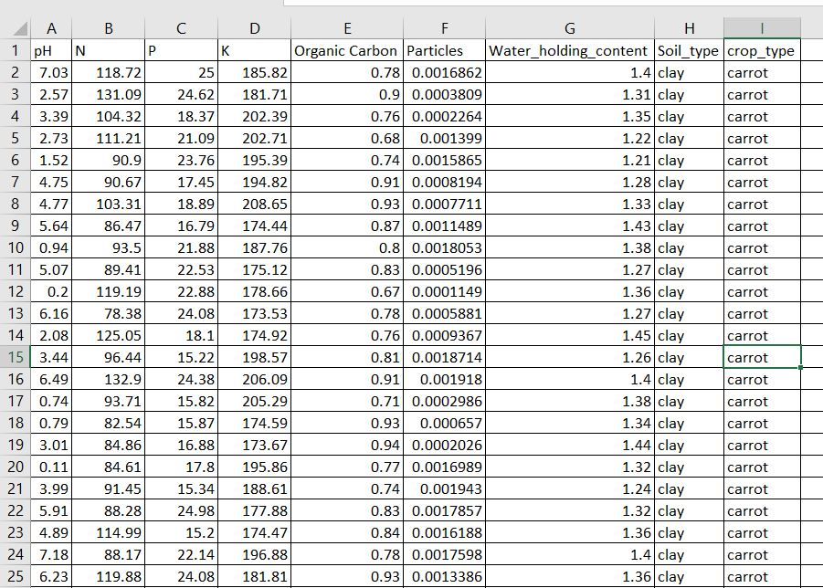

Slide 21
Data Sets
Type of Soil | Suitable Crop | Remarks
Sandy Soil | Melon and Coconut are good for this soil | If water is available then maize, millets barley can be grown
Clayey Soil | Paddy can be grown | Irrigation is required , Rich in organic Matter, Good water holding capacity
Loamy Soil | Wheat, Sugarcane, Cotton, Jute, Pulses and Oilseeds | Good water holding capacity, Roots of plants get enough water, air and space
Black Soil | Ideal for growing crops like tobacco, wheat, millets | Also known as Black Lava soil, formed from lava rocks and rich in clay
Red Soil | Pulses, wheat, millets, cotton and tobacco | Not Fertile soil, Red color is due to presence of Iron Oxide

Slide 22
Soil Analysis
In this phase soil will be characterized by different factors like, Nitrogen, Phosphorous Content, Rainfall, Humidity, Temperature etc.
We have collected various datasets for soil and crop analysis

Slide 23
Training Of Model
In this phase we will train our model with various soil and crop datasets.
Approximately 3/4th of the datasets will be used to train the model.

Slide 24
Testing Of Model
In this phase, we have tested our model with Support Vector Machine Algorithm.
1/4th of the datasets, we will use for testing.
In this phase, we have got the accuracy of 56%.
Model will be able to predict the best suitable crops considering the various factors of soil and climatic conditions.

Slide 25
Algorithm
SVM(Support Vector Machine):-
Support Vector Machine or SVM is one of the most popular Supervised Learning algorithms, which is used for Classification as well as Regression problems..
The goal of the SVM algorithm is to create the best line or decision boundary that can segregate n-dimensional space into classes so that we can easily put the new data point in the correct category in the future. This best decision boundary is called a hyperplane.

Slide 26

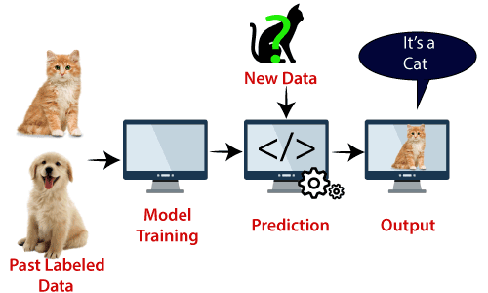
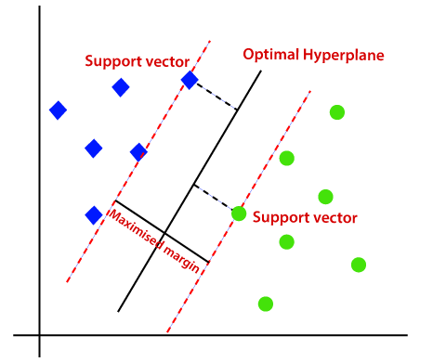
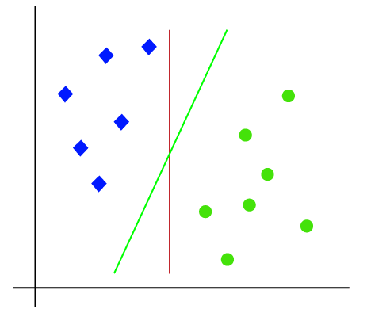
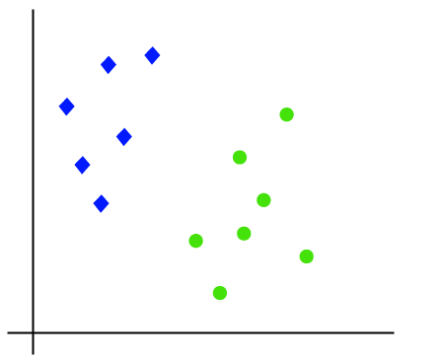

Slide 27
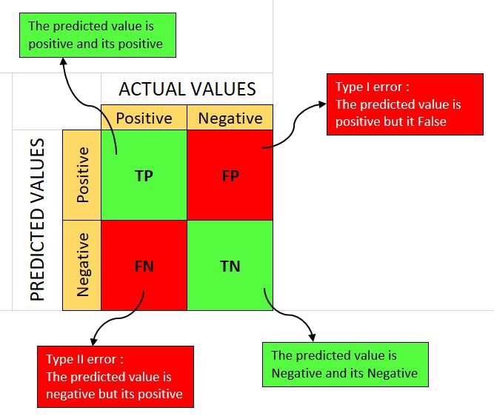
Confusion Matrix
A Confusion matrix is an N x N matrix used for evaluating the performance of a classification model, where N is the number of target classes.
The matrix compares the actual target values with those predicted by the machine learning model.

Slide 28
Result & Discussion
Accuracy of the model in the Initial phase = 0.56
[[ 0 0 0 0 0 0 2 11 0 0]
[ 0 0 0 0 11 0 0 0 0 0]
[ 0 0 0 11 0 0 0 0 0 1]
[ 0 0 0 39 0 0 0 0 0 0]
[ 0 0 0 0 38 0 0 0 0 0]
[ 0 0 0 5 0 0 0 0 0 0]
[ 0 0 0 0 0 0 4 11 0 0]
[ 0 0 0 0 0 0 3 31 0 0]
[ 0 0 0 12 0 0 0 0 0 2]
[ 0 0 0 19 0 0 0 0 0 0]]

Slide 29
To Overcome with the Low accuracy
In this phase, we have only used Linear Support Vector Machine algorithm, not the Kernel Function. So, By using Kernel function Accuracy will be enhanced
More Iteration of data points is required
More training of the model with various datasets.

Slide 30
Future Plan
In the Upcoming time, we will implement the Model –
“Soil Health Analysis and Crop Recommendation using Textual Data of Soil with the application of Machine Learning”.
We will work on the factors that are affecting our accuracy.
We will work in improving the accuracy of Model.
We will make a web application or interface for use, so that they can use the model in an easy manner.

Slide 31
References:
International Conference on Communication and Signal Processing, April 4-6, 2019, India
2016 IEEE Eighth International Conference on Advanced Computing (ICoAC)
Title – CROP YIELD PREDICTION USING MACHINE LEARNING Details – Mayank Champaneri Chaitanya Chandvidkar Darpan Chachpara Mansing Rathod (Department of Information technology, K.J. Somaiya Institute of Engineering and Information Technology, University of Mumbai, India)
Title – AgroConsultant: Intelligent Crop Recommendation System Using Machine Learning Algorithms.
Details – Zeel Doshi, Subhash Nadkarni, Rashi Agrawal, Prof. Neepa Shah(Dwarkadas J. Sanghvi College of Engineering) Mumbai, India.
Title – Agro based crop and fertilizer recommendation system using machine learning
Details – Preethi G, Rathi Priya V, Sanjula S M, Lalitha S D, Vijaya Bindhu B(R.M.K Engineering College)

Slide 32
Title – Hybrid Method for Improving Accuracy of Crop Type Detection Using Machine Learning.
Details – Ankit, Arun, Mahule (Dr. A.J.Agrawal); Department of CSE(Shri Ramdeobaba Kamla Nehru Engineering College, Nagpur – 440013, Maharashtra, India)
Title – AN APPROACH FOR PREDICTION OF CROP YIELD USING MACHINE LEARNING AND BIG DATA TECHNIQUES
Details – Kodimalar Palanivel, Chellammal Surianarayanan(Bharathidasan University Constituent Arts & Science College) Navalurkuttapattu, Tiruchirappalli, TamilNadu, India.
Title – Crop Prediction System using Machine Learning Algorithms.
Details - Ajinkya Patil , Pavan Patil , Prof. Shrikant Kokate(Dept. of Computer Engineering, Pimpri Chinchwad College of Engineering) Pune, Maharashtra, India

Slide 33
Title – Survey Of Crop Recommendation Systems
Details – Deepti Dighe, Harshada Johi, Aishwarya Katkar, Sneha Patil, Shrikant Kokate
(Department of Computer Engineering, Pimpri Chinchwad college of Engineering, Pune, Mahrashtra India)
Title – Prediction Of Crop Yield and Fertilizer Recommendation Using Machine Learning Algorithm
Details – Devdatta A Bondre, Mr. Santosh Mahagaorkar
(NICT Solution & Research Delagavi, Karnataka, India)
https://youtu.be/e99LZoii3ng
https://www.kaggle.com/
https://www.javatpoint.com/machine-learning-support-vector-machine-algorithm

Slide 34


